Slide 1
The E Factor
A Corporate Communications & Team Engagement
Initiative for Leaders
Patricia A. Kimerer, PWE
Notes:
Engaging & Empowering through Positive Motivation and Strategic Accountability

Slide 2
Walking the Talk
Connecting the Dots to Achieve:
~Effective Communication
~Excellent Client Service
~Personification of the “HBK Way”
~Fulfillment of the HBK Promise (Work/Life Balance)
~Fruition of our Mantra
~Strengthening of our Brand
~Our Future Growth & Expansion
Notes:
Co-Worker & Customer Service – this is our #1 priority next to quality of services. Mutual respect between colleagues is imperative to our ultimate, collective success as a family of firms. How can we expect that our clients will feel they’re receiving the best service if we don’t treat them –and one another-- with value, dignity, and common courtesy? Leading by example in terms of respectful behavior is key.

Slide 3
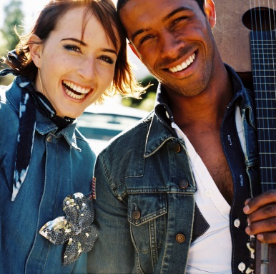
Research Shows Happy Staff =
Increased Productivity
“We find that human happiness has large and positive causal effects on productivity,” the team says. Positive emotions appear to invigorate human beings, while negative emotions have the opposite effect.”
“Happier workers … were 12% more productive. Unhappier workers were 10% less productive.”
“The organization reports that disengaged employees’ lost productivity costs U.S. businesses more than $300 billion a year.”
~Rob Markey, Harvard Business Review
Notes:
The more you value your team, the more they want to do a good job FOR YOU.

Slide 4
Can’t Get No…Satisfaction
“For strategic talent management, forget surveying satisfaction. The meaningful focus should be on engagement…
Engagement is about mutual commitment. Companies help employees reach their potential and employees help their companies perform better…
This combination results in engagement—‘the capture of discretionary effort.’ ”
~Allan Benowitz, VP of Growth & Development,
The Employee Engagement Group

Slide 5

Engagement Breeds Loyalty
Nearly 60% of 12,205 full-time workers polled said they were
“highly engaged” because they received communication from senior managers monthly.
In contrast, 42% of low-engaged employees say they receive
only annual communication or no communication at all . . .
~ Watson Wyatt “Work USA” Survey

Slide 6
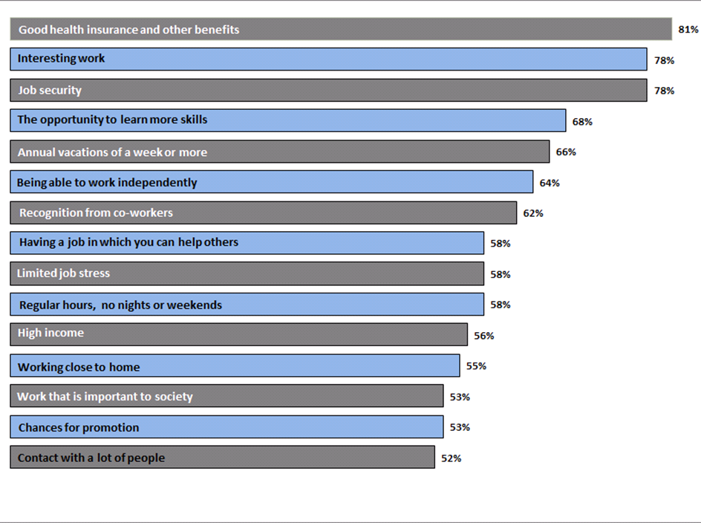
What U.S. Workers Really Want
Job characteristics rated “most important” by U.S. workers in recent Gallup poll.
Notes:
See the recurring theme? People want and need to feel valued to become engaged.

Slide 7
Need More Proof?
According to an Employee Engagement Benchmark Study by Temkin Group, highly engaged employees are:
480% more committed to helping their company succeed.
250% more likely to recommend their company as an employer.
370% more likely to recommend improvements.
A Gallup study of 192 organizations showed levels as follows:
Engaged—30%
Not engaged—52%
Actively disengaged—18%

Slide 8

Broken Engagement: Causes for Concern
“I fear I might be next.”
“Why are we having layoffs? We’re still making money.”
“They said I would be promoted in 2 years.”
“When the economy improves, I’ll leave.”
“I don’t like it here, but no one is hiring now.”
“I wanted to retire, but now I have to work.”
“They no longer offer flex time.”
-HR Daily Advisor, April 2014
Notes:
What are some signs that the team might not be engaged? Do you hear these types of comments?

Slide 9

Can This Marriage Be Saved?
What are other red flags when it comes to engaging the team?
Verbal, non-verbal, written and even electronic communication all sends a message of value to the recipient.
What is Engagement, Really?
Notes:
Chronically unanswered calls, e-mails
Needless cc’ing of executives
Interruption of meetings &/or dismissal of attendants
Public reprimand
Hiding behind the phone or your computer
Insensitive non-verbal cues
(Unwelcoming or dismissive hand gestures, head shaking back & forth, negative facial expression)
Being an inactive listener
(Not looking up from your computer during a face-to-face conversation)

Slide 10

Remember, Grumpy Rolls Downhill
& Sideways & Everywhere Else …
Words Matter - Be Careful When Advising Others
Chronically unanswered calls, e-mails
Needless cc’ing of executives
Interruption of meetings &/or dismissal of attendants
Public reprimand
Hiding behind the phone or your computer
Insensitive non-verbal cues
(Unwelcoming or dismissive hand gestures, head shaking back & forth, negative facial expression)
Being an inactive listener
(Not looking up from your computer during a face-to-face conversation)
Notes:
A bit of humor; clearly none of us mentors like THE OFFICE… but what IS EE, actually?

Slide 11
DOES IT REALLY WORK?
Emerald Coast Hospital of the Sacred Heart Health Systems, FL
        Started in the 18th percentile for patient satisfaction
        Raised to 87th percentile in four months
        Through EMPLOYEE ENGAGEMENT
        Accountability Model, Leadership Council
    ENCOURAGING ENGAGED EMPLOYEES & ELIMININATING DISENGAGED EMPLOYEES
~Independent Hospital Network Leadership College Graduation
Notes:
DOES IT WORK? Hex yeah! Here’s an example from a different industry; healthcare. ECH eliminated 1% of their workforce – the percentage that wasn’t engaged (WHICH WE MUST ALSO BE WILLING TO DO) and jumped up a staggering 69 percentile in patient satisfaction scores…incidentally reimbursement for hospital is tied to these scores; it’s how they’re paid.

Slide 12

AND HERE IN OUR WORLD…
Firm: RSM Gladrey in Cedar Rapids, Iowa
Issue: Flexible Work Program
Case Study: Manager Michelle Krapfl was to work 30hrs/wk. but duties dictated longer hours
Solution: Krapf was given the option to transfer to another unit in which she job-shares with other part-time managers
Results: RSM retained a valued resource in Krapfl and the precedent was set to implement practical work/life balance policies.
… and then RSM was named Best Business Consulting Firm and Best Accounting Firm for that year by the Corridor Business Journal
COINCIDENCE?

Slide 13
ON LAND or SEA: ENGAGEMENT is KEY
A recent Aberdeen Group survey notes senior executives listed Employee Engagement as their number one concern. Think of it as a boat on which:
31% of the crew is actively running the boat.
52% percent of the crew is there but looking at the scenery.
18% percent of the crew is
actively trying to sink the vessel.
Notes:
Statistics from the survey transformed into an analogy; will we sink or swim?

Slide 14
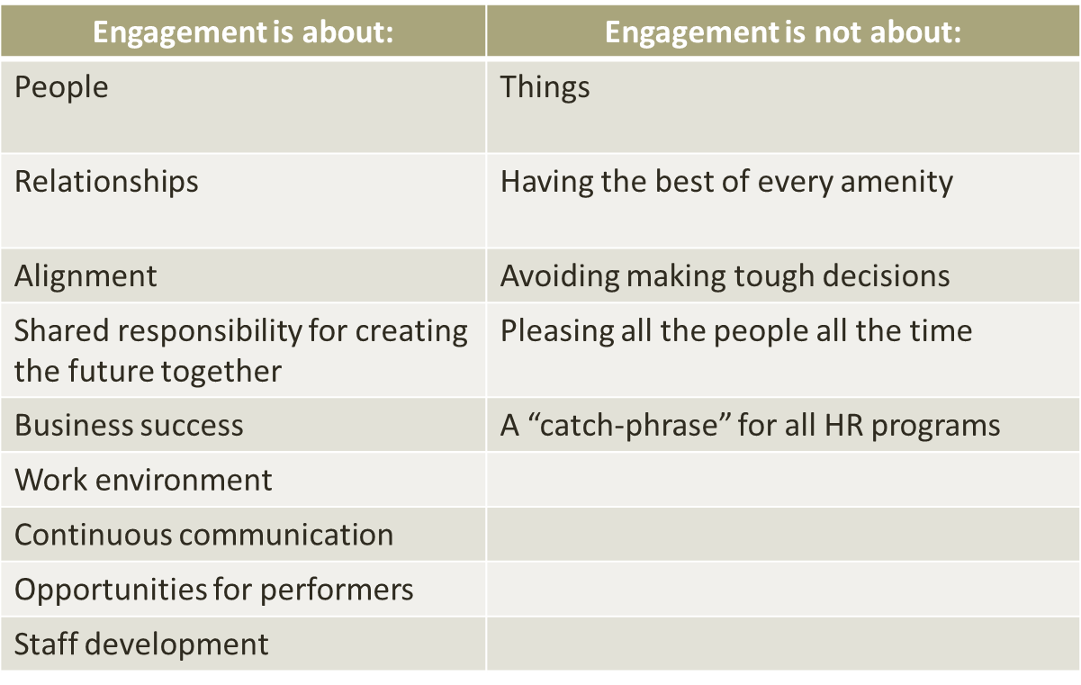
HOW IT WORKS

Slide 15

Engagement Builds Teams
"A group becomes a team when each member
is sure enough of him or herself and their contribution to praise the skill of the others."
~Norman Hidle, Motivational Speaker
Notes:
Are we there yet?

Slide 16
Engagement – Inside & Out
“It all boils down to taking care of your brand & the message you are putting out in the market. If your people are unhappy, they aren’t going to perform at their best… if they dislike their managers, this is bound to show up in the quality of their work & their overall attitude about your firm. Whether you realize it or not, your employees are out there representing your firm at every moment, on or off the clock. ..you want your people to say good things (because they're true). No amount of careful messaging and good marketing can overcome the actions and words of disgruntled staff.”
~Accounting Today article excerpt by Bonnie Buol Ruszczyk, President, BBR Marketing
Notes:
Please take a moment to read this…truer words were never spoken!

Slide 17
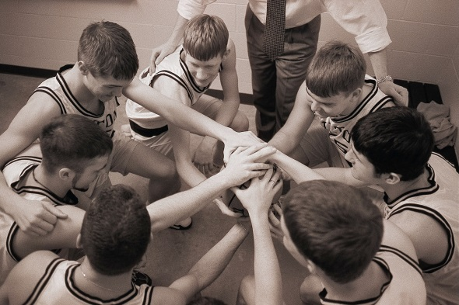
The End Goal
“Perhaps one of the most important findings of our study is one that belies simple logic:
Engaged colleagues have an emotional bond & psychological commitment to their jobs and their employers.”
~Paller & Perkins Study

Slide 18
WHERE DO WE NEED IMPROVEMENT?
-What are the top challenges in your office?
Bullies? Passive/Aggressive team members? Rumor mongers? Clock watchers?
-Which hurdles are stopping your team from thriving?
Burnout? Apathy? Subtle insubordination?
-Which team members need EE most & are the right team members being empowered?
Who needs encouraged? Who needs rewarded? Who needs redirected?
-Do our leaders reflect the HBK Way philosophy?
Are our top managers fulfilling the mission & meeting expectations?
-Are we holding team members accountable?
For both good and bad behavior? Are we having
both the ‘attaboy’ & tough conversations as needed?
Notes:
Only YOU know your team, office and region best. What are your specific challenges???

Slide 19

WHAT WE NEED TO SUCCEED…
-YOU!
-Executive Support
-EE Buy-In from the Top Down
-Commitment to Empathy in Practice
-Shaping a Team of 300+ Happy Team Members
-Dedication to Accountability & Supporting a TRUE TEAM ENVIRONMENT …
INSPIRING GROWTH, EXPANSION, SUCCESS!
Notes:
Are you in???

Slide 20

RESOURCES to HELP
-Communication Coaching
-Team-Building/Leadership Training
-Setting and Managing Expectations
-Business & Practice Development Techniques
-Soft Skills Refresher Courses
-New, Formal EE/Mentoring Programs
-New Resource Groups
Notes:
We’re here to help!

Slide 21

Getting Started
-Establishing EE as a formal part of the HBK culture
-Updating/creating a job description for every team member that clearly outlines expectations
-Reinforcing HBK positives; empowering those with an attitude of gratitude & holding everyone accountable for their performance both good and bad
-Implementing regular team surveys & using the results to establish new programs/initiatives
-Celebrating hard working team members with small but impactful rewards
-Creating firm brand for philanthropy in all regions
-Setting a date to start
Notes:
EE should be as important as HR, continuing ed, IT training… everyone needs to know they’re valued and heard – but also that they must work hard to achieve great things…bring lunch in – give gift cards, leave thank you notes with candy, show appreciation in a small but tangible way! The program should be formally announced and outlined by the Principal group.

Slide 22
A Parting Thought or Two:
Empathy Tips from Some of the Greats
“Do not wait for [others] to be kind –
do it alone, person to person.”
“Wherever there is a human being,
there is an opportunity for kindness.”
“Life’s most persistent and urgent question is:
‘What are you doing for others?’ ”
“Be the change you want to see in the world.”
Notes:
Maybe listening to the words of some of the folks who’ve had the greatest success in terms of leader servitude and empowering others can give us inspiration. One person CAN change the world—maybe not it in obvious, overt ways like finding the cure for polio; but in little ways that matter in the lives of others. Can you ID the world leaders who said these quotes?
Mother Teresa: Catholic Nun & Founder of the Missionaries of Charity
Seneca: Roman Philosopher
Martin Luther King, Jr.: American Clergyman & Civil Rights Activist
Mahatma Ghandi: Indian Political Activist & Freedom Fighter
The truth is: we DO set the bar. We MUST lead by example. And if we want the greater collective team to follow, we must lead them in the right direction. People just want to feel valued…One person CAN change the world. Let’s use our powers for good!

